Slide 1

REAL-TIME HUMAN FALL DETECTION USING YOLOV8 AND OPENCV
ABHIJITH KORUKONDA (20261A6602)
IRAGAVARAPU SRI RAMA SAKETH (20261A6626)

Slide 2
1
ABSTRACT
Falls among individuals pose serious risks to their health and independence, underscoring the importance of effective fall detection solutions. This study aims to address this critical issue by proposing a novel approach that integrates Computer Vision and Deep Learning for Real-time fall detection and assistance. Traditionally, fall detection systems have relied on wearable sensors, which, despite their widespread use, often suffer from drawbacks such as false alarms and discomfort for the wearer. In response to these limitations, this project introduces an efficient solution by leveraging Computer Vision and Deep Learning. The core of this innovative system lies in the integration of the YOLOv8 (You Only Look Once) which is a cutting-edge, real-time object detection algorithm that uses Convolutional Neural Network (CNN) to predict the bounding boxes and class probabilities of objects in input images with Computer Vision. YOLOv8, a variant of the YOLO object algorithm series, has demonstrated superior performance in identifying various objects, and therefore has been used in detecting fall events, with remarkable accuracy and efficiency. By combining the strengths of YOLOv8 and Computer Vision, this solution offers improved accuracy and reliability in identifying fall events and also enhances the overall user experience by providing timely assistance and ensuring the safety and well-being of individuals.

Slide 3
2
OVERVIEW
Introduction
Requirement Specifications
Existing System
Design and Methodology
Proposed System
Conclusion

Slide 4
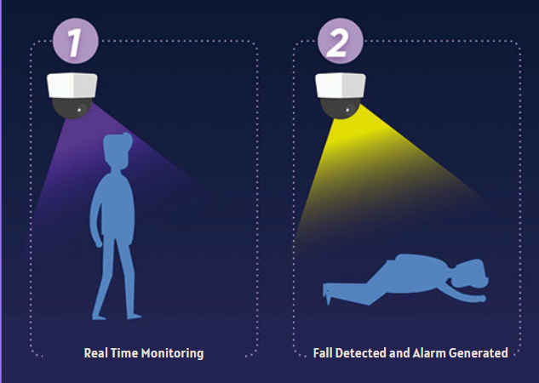
3
INTRODUCTION
Falls pose a significant challenge to many people in healthcare and beyond, causing serious injuries and health problems.
This project addresses this challenge through the development of a cutting-edge Real-Time Monitoring System for Individuals.
Unlike conventional systems, our solution integrates computer vision and a state-of-the-art deep learning model to provide real-time fall detection capabilities.

Slide 5
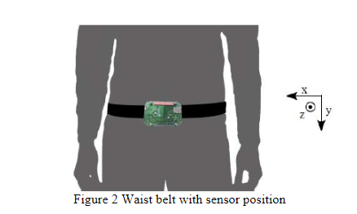
4
EXISTING SYSTEM
Traditional fall detection systems often rely on wearable sensors like gyroscopes and accelerameters for collection of data
ML algorithms are used to train models based on this data, which may pose challenges related to user compliance and comfort.
Also the wearable sensors often give inaccurate results.

Slide 6
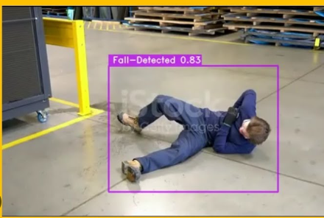
5
PROPOSED SYSTEM
The proposed system using a deep learning object detection model called the YOLOv8 which is the 8th version of the YOLO(You Only Look Once) model
The model is trained on custom datasets of about 8000 images.
This system offers a more comprehensive and accurate approach to detecting falls in real-time

Slide 7
6
REQUIREMENTS SPECIFICATION
HARDWARE:
RAM: 8 GB
PROCESSOR : intel i5
ROM: 256 GB
GPU: MIN 4 GB
SOFTWARE:
Language: python
Operating System : macOS or Windows or Linux
IDE: Google Colab or Jupyter notebook

Slide 8
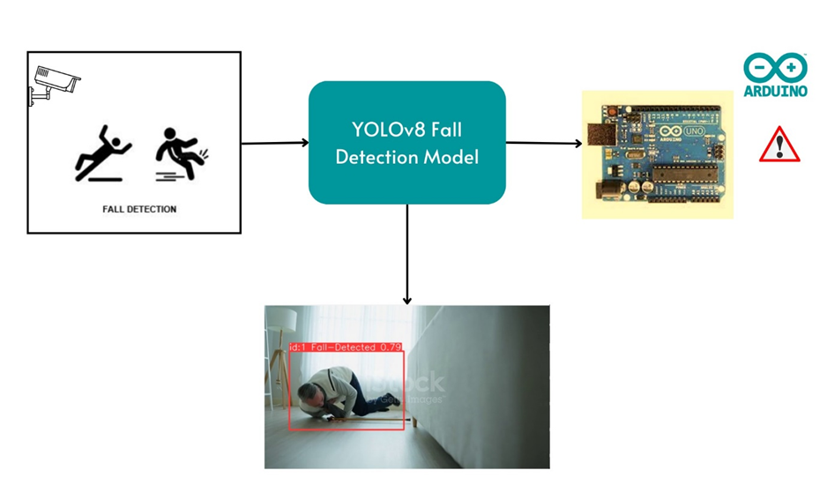
7
HOW THE SYSTEM WORKS ?

Slide 9
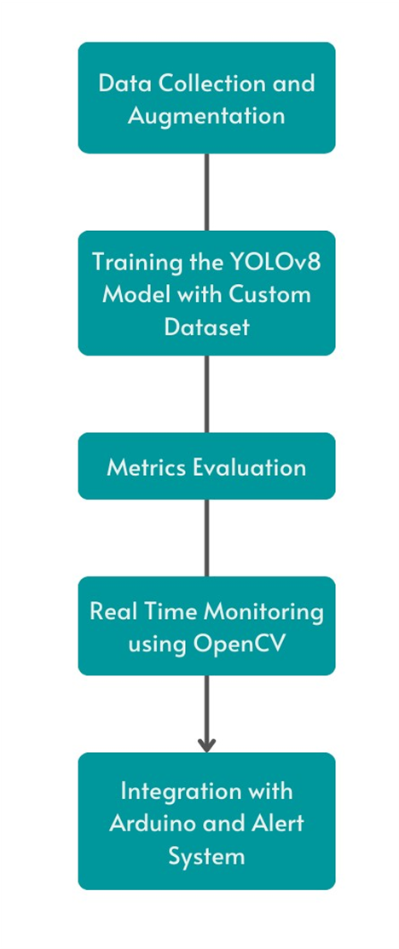
8
DESIGN AND METHODOLOGY

Slide 10
9
DESIGN AND METHODOLOGY
This meticulous approach to preprocessing and augmentations, applied to our dataset of 8,500 images with a distribution of 7,000 for training and 1,500 for validation, ensures that our fall detection model is well-equipped to handle a wide spectrum of real-world scenarios. These enhancements contribute to the model's adaptability and generalization capabilities, aligning with our goal of creating a robust and effective fall detection system.
Phase 1
Data Collection

Slide 11
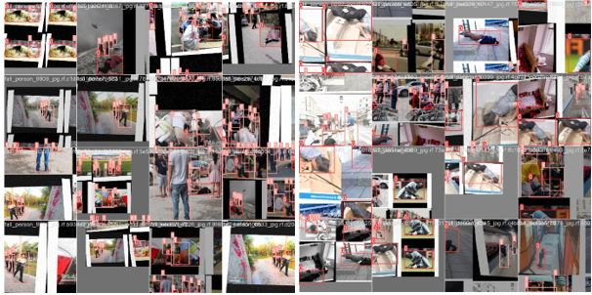
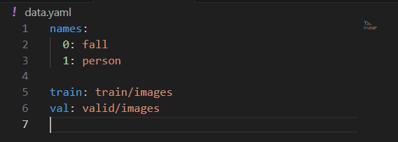
10
Phase 1
Data Collection

Slide 12
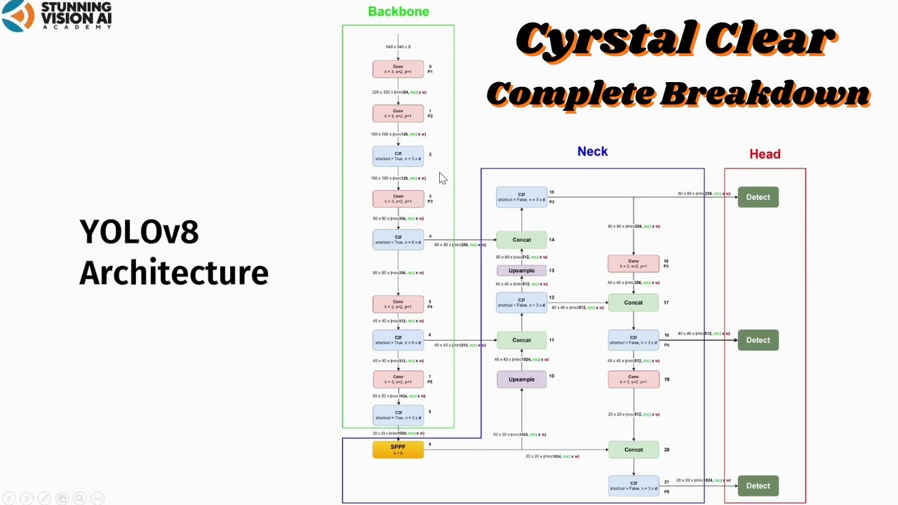
11
DESIGN AND METHODOLOGY
Phase 1I
Training

Slide 13
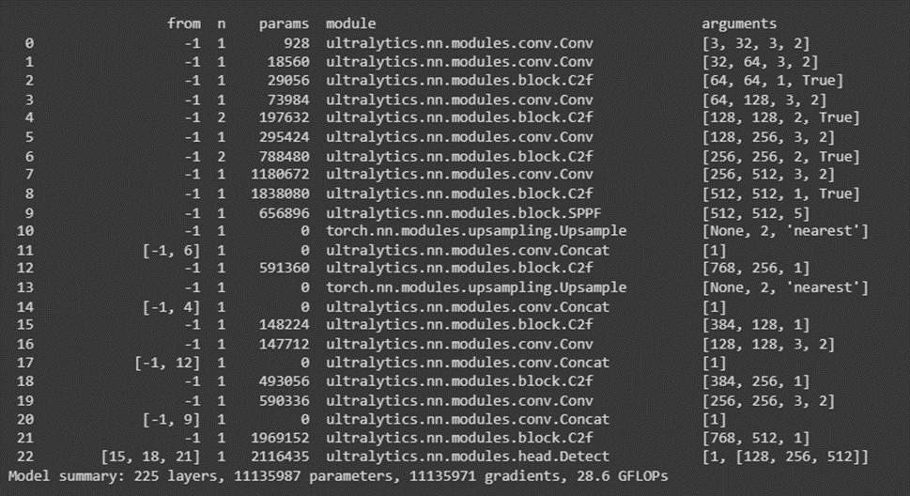
12
Phase I1
Training

Slide 14
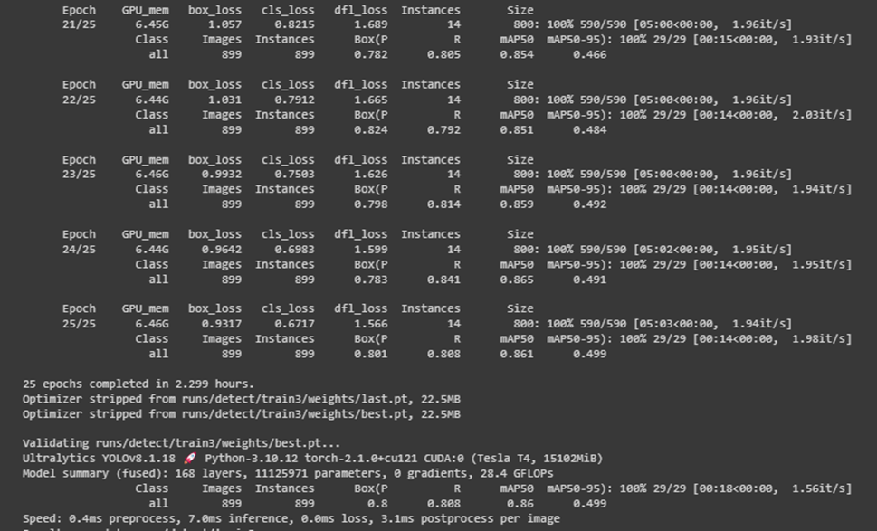
12
Phase I1
Training

Slide 15
13
DESIGN AND METHODOLOGY
A pivotal step in our design and methodology involved the meticulous evaluation of key performance metrics to assess the effectiveness of our custom YOLOv8 model in elderly fall detection. Leveraging the confusion matrix, we conducted a comprehensive analysis encompassing metrics such as accuracy, false positives, false negatives and precision
Phase 1II
Metric Evaluation

Slide 16
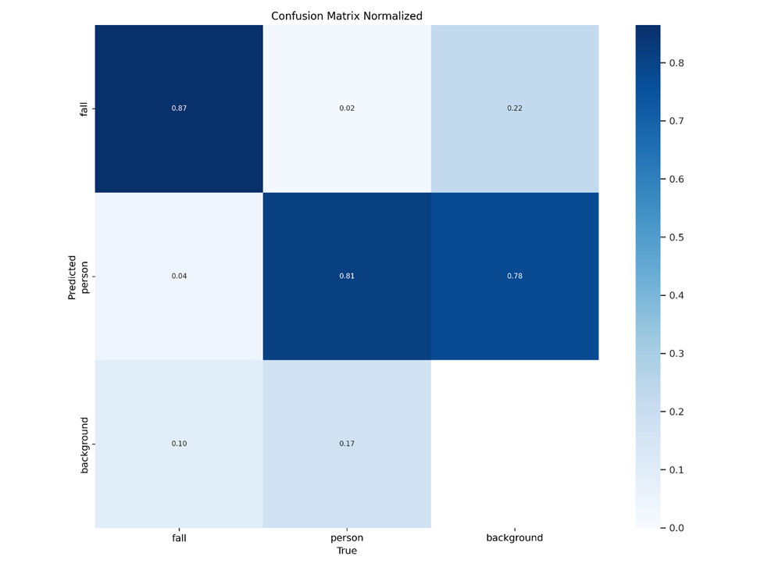
14
Phase II1
Metric Evaluation
Accuracy: Accuracy measures the overall correctness of the model's predictions.
Accuracy=Number of Correct Predictions/Total Number of Predictions
Accuracy = 87%
Precision: Precision measures the proportion of true positive predictions among all positive predictions made by the model.
Precision=True Positives/True Positives+False Positives
Precision = 80%
Recall: Recall measures the proportion of true positive predictions among all actual positives in the dataset.
Recall=True Positives/True Positives+False Negatives
Recall = 80%

Slide 17
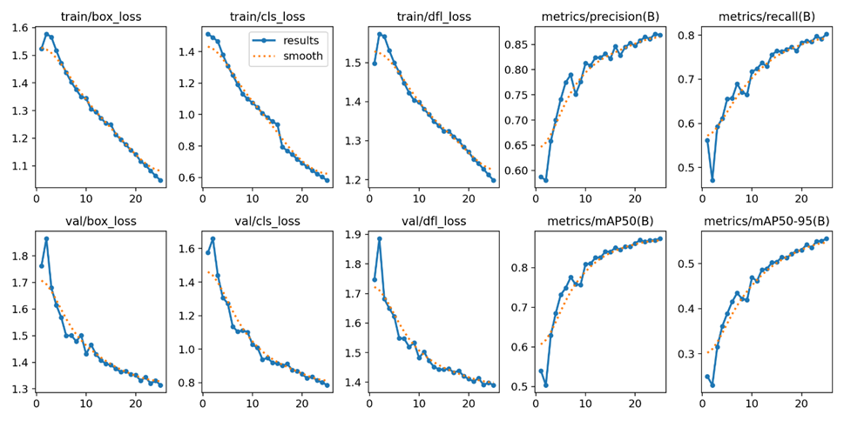
14
Phase II1
Metric Evaluation

Slide 18
15
DESIGN AND METHODOLOGY
To bring our fall detection model into real-world scenarios, we seamlessly integrated the OpenCV library, a versatile computer vision toolkit renowned for its extensive capabilities. OpenCV provided a robust platform for implementing our YOLOv8 model on both test videos and live camera feeds, enabling real-time monitoring of fall events.
Phase 1V
Real Time Monitoring
Using OpenCV

Slide 19
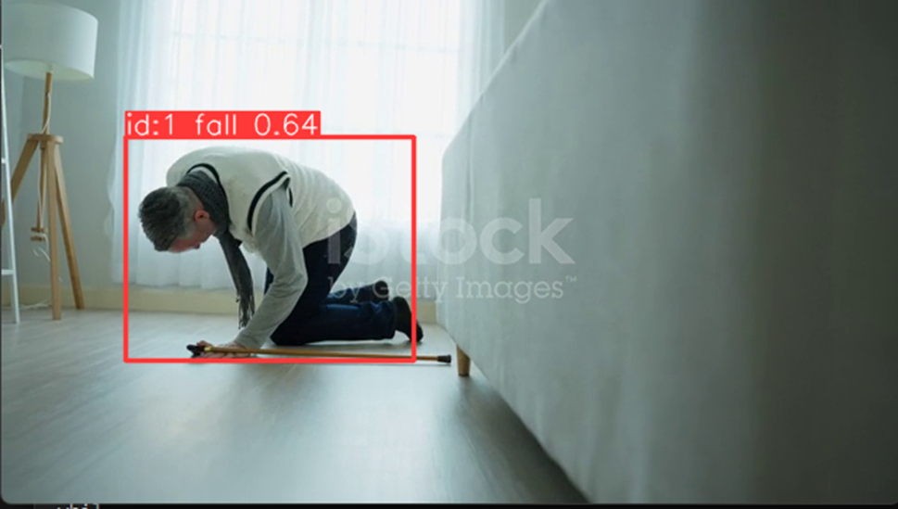
16
Phase IV
Compiling and training

Slide 20
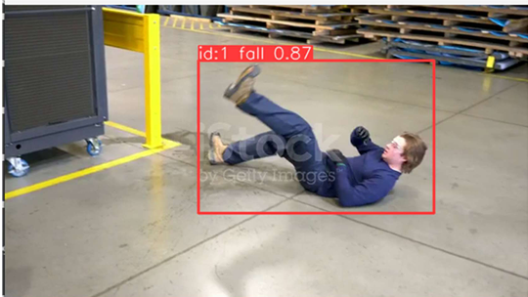
17
Phase IV
Compiling and training

Slide 21
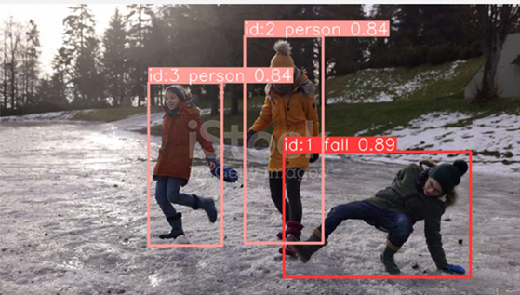
18
Phase IV
Compiling and training

Slide 22
19
DESIGN AND METHODOLOGY
In the integration phase of our design, we can seamlessly merge our fall detection system with hardware components to enhance its real-world applicability. The chosen hardware solution for this integration was Arduino, a versatile microcontroller platform. Our goal was to connect the fall detection system to a sound alert generator, creating a responsive alert mechanism for immediate intervention when a fall is detected in real-time.
Phase V
Sound Alert

Slide 23
20
CONCLUSION
In conclusion, the project has successfully advanced fall detection technology through the integration of cutting-edge computer vision capabilities with Arduino microcontrollers. By rigorously evaluating our custom-trained YOLOv8 model, we have demonstrated exceptional computational efficiency and accuracy in detecting fall events in real-time.
Furthermore, the integration of Arduino microcontrollers enhances the system's functionality by providing a versatile and cost-effective platform for real-time monitoring and response mechanisms. Arduino boards serve as central processing units, receiving input from cameras, analyzing data using the YOLOv8 algorithm, and triggering appropriate actions, such as activating LED indicators and buzzing a buzzer, to signal a fall event.
In summary, by combining the strengths of YOLOv8 computer vision with Arduino technology, our project offers an innovative solution that addresses the limitations of traditional fall detection systems. Future efforts will focus on refining and optimizing the system for real-world deployment, with the ultimate goal of improving the quality of life for elderly individuals and their caregivers. This project represents a significant advancement in fall detection technology, promising improved accuracy, reliability, and user experience.

Slide 25
THANK YOU
ABHIJITH KORUKONDA (20261A6602)
IRAGAVARAPU SRI RAMA SAKETH (20261A6626)

